Slide 1

Lessons Learned from applying Generative AI to apps with .NET and Azure

Slide 2
Tech stack and Architecture for a .NET AI RAG application
Benefits and shortcomings of simple RAG implementations
RAG Challenges and Solution Strategies
Evaluations for AI Assistant responses
AI Agents with Semantic Kernel and .NET
Model deployment options with Azure OpenAI
Lessons Learned
Use case discovery
Agenda

Slide 3
Opportunity for .NET Developers
Generative AI models have made AI accessible to App Dev Engineers - It’s an http call
We know how to build, deploy, launch, scale and maintain apps and systems
.NET has Azure and Semantic Kernel SDKs for productivity
Use the same .NET and Azure stack we know and love
AI wave is Faster and more accessible than Mobile, Cloud, DevOps, Platform Engg waves
It’s still 20% Advanced AI model capabilities, and 80% app-and-data engineering work

Slide 4

H&R Block delivered .NET and AI Enabled Capabilities on Azure for Tax Season 2024
For HRB Customers
AI Tax Assist for DIY TaxPrep
Voice enabled GenAI Agent for Customer Support
For HRB Associates
Private and Secure ChatGPT App for associates
Multiple RAG and Agentic Apps experimented and tested

Slide 5
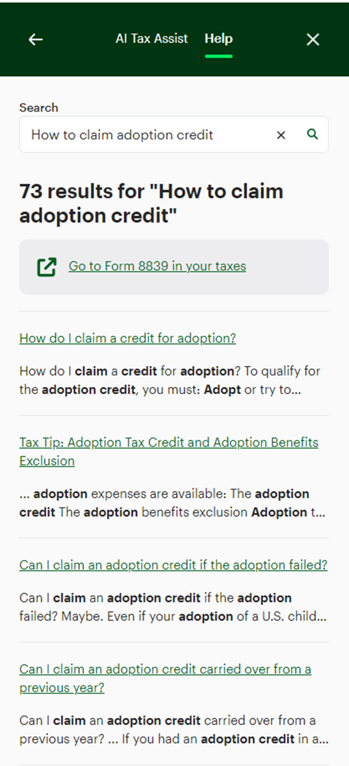
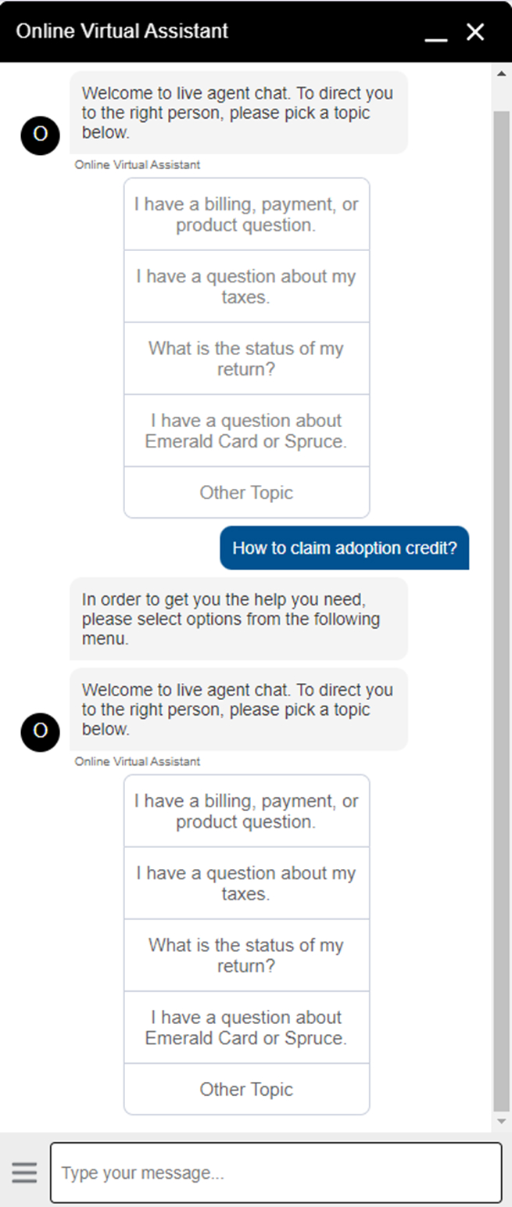
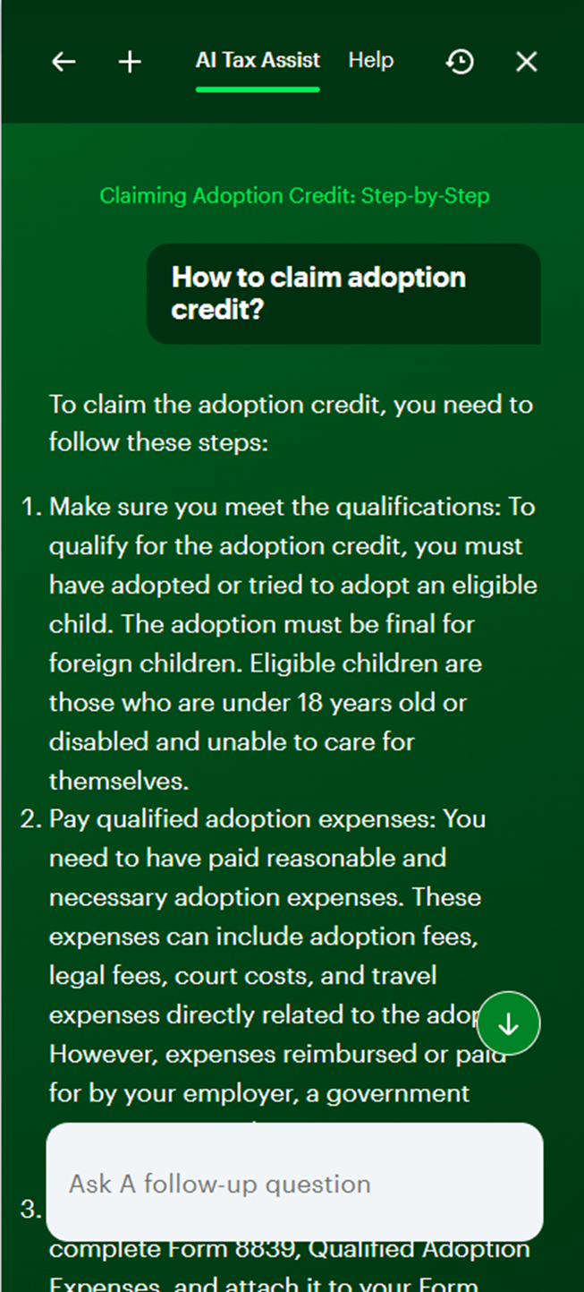
AI Tax Assist – from Lookup to AI infused Conversational UX

Slide 6
AI Tax Assist – Demo

Slide 7
Tech Stack
Application
Infrastructure
.NET 8 and C#
.NET Web API - .NET and Python
Azure Functions - .NET and Python
SignalR Hub
Azure OpenAI SDK
Semantic Kernel
Presidio SDK
CosmosDB Integration
Azure Storage Integration
Blazor Server App
Angular
Azure OpenAI Service
Azure App Service, Azure Functions
App Service Environment
Application Gateway
CosmosDB
Azure SignalR
Azure Data Factory
Application Insights
Azure SQL Database
PowerBI

Slide 8
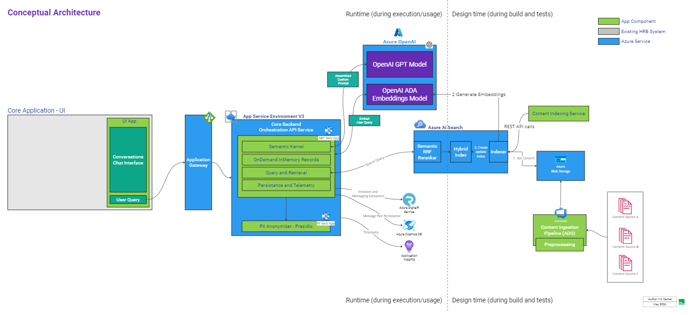
Architectural Pattern

Slide 9
Benefits and shortcomings of simple RAG implementations
Benefits
Shortcomings
Augment LLM with domain specific knowledge base
Faster and easier to build a v0.1 application
Azure AI Search, SK in-memory store
Simple design and architecture
Guardrails and accuracy, very time consuming and iterative
Journey to V1 long drawn out
Low user satisfaction on Quality and Accuracy of responses
Gradual increase in complexity

Slide 10
RAG Challenges and Strategies
Search is retrieving content not relevant to user query | Prompt the LLM to ignore content NOT relevant Try a different embedding model like ADA-3-large Use metadata tagging filter search results Try larger chunk sizes
Search is not retrieving content we know to be relevant to user query | Do we have the content? If not, add the content Metadata filters missing? Add them Try larger chunk sizes
LLM Response is a jumbled-up mish-mash of all the passages sent in the context window | Prompt the LLM to only use the relevant passages Try a different embedding model (ada-3-large?) Additional metadata tagging
User query is a follow up query that does not need Retrieval (Tell me more, I don’t understand) | Do intent detection before triggering final LLM call Reform the retrieval query using chat history (n-1)
Challenges
Solution Strategies

Slide 11
Evaluations for AI Assistant responses
Using LLMs to evaluate + Humans can do manual eval on sampling
Azure AI Studio
Build your own
Groundedness : Alignment between grounding context provided and AI response
AACS (Custom fine-tuned model that can score) and Prompt-only
Coherence : Linguistic measure for natural, human-like flow in AI Response
Relevance : Relevancy of the AI response to the context provided
Helpfulness : Determines how helpful/useful the response is to the user, requires system context
Key point evaluation: Manual key points on benchmark Q&A dataset to evaluate AI response

Slide 12

Agentic Group Chat App with Semantic Kernel
https://devblogs.microsoft.com/semantic-kernel/introducing-agents-in-semantic-kernel/
Notes:
Starting 15 minutes

Slide 13
Model deployment options with Azure OpenAI
Standard - Pay-As-You-Go
Provisioned Throughput Units (PTUs)
Start with “Standard” for lower environments – Dev, QA
Tokens per Minute (TPM), Number of API Calls are key measures
Come up with throughput requirements based on existing data – take a swag
Use the Capacity Calculator tool in Azure OpenAI Studio or use excel
Test it with lowest PTUs possible (50) in Load Environment and increase as needed
In Production, find the benchmark workload to optimize PTUs
Use a fallback “Standard” deployment for resiliency
https://learn.microsoft.com/en-us/azure/ai-services/openai/how-to/provisioned-throughput-onboarding
Notes:
20 minutes

Slide 14
Lessons Learned
Key Takeaways
Think Human-like Assistant, Not ChatBot v2
UI makes AI work – chat is not the only way
Time for Evaluation and Testing >>> Development
Pick a leading model and stick to it
Don't Sweat the Small Stuff – ex: configuration parameters, temperature, top_p
Reports and Data from day 1 – MoMo (Model Monitoring)
Continuous Improvement of Eval Pipelines

Slide 15
Lessons Learned
Insights​
Prompt Engineering requires iterations, and extending your programming skills with language skills
The more steerable the LLM is, the more sensitive it is to your words, characters, structure and placement
Reasonable level of comfort with inherent uncertainty is required
Quality of outcomes is more important than response times.
Multi-agent, Action based plugins (ex: WebSearch/API call) and Advanced Tree-of-thought prompting is a powerful combination for Reliability, Accuracy, real-time information

Slide 16
Use case discovery
Questions to ask​
Does it require human-like text generation?
Does it require structured code generation?
Does it have defined inputs and outputs? For text and/or image(s)
Can the definition of input and output be documented with a prompt engineering mindset?
Does it work well with stateless design? Ex: Commit Message Gen with GitHub Copilot
Can the input and output fit into the token limit?
What is the level of determinism required for the output?
Notes:
25 minutes

Slide 17
Resources
How to add genuinely useful AI to your webapp (not just chatbots) - Steve Sanderson
https://www.youtube.com/watch?v=TSNAvFJoP4M
Must watch –
Steve Sanderson goes beyond just chatbots for other use cases
How we should discover and execute on this opportunity

Slide 18
Thank you

Slide 19
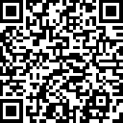
.NET Conf: Focus on AI
Learn more
aka.ms/dotnetFocusAI/Collection

